Slide 1
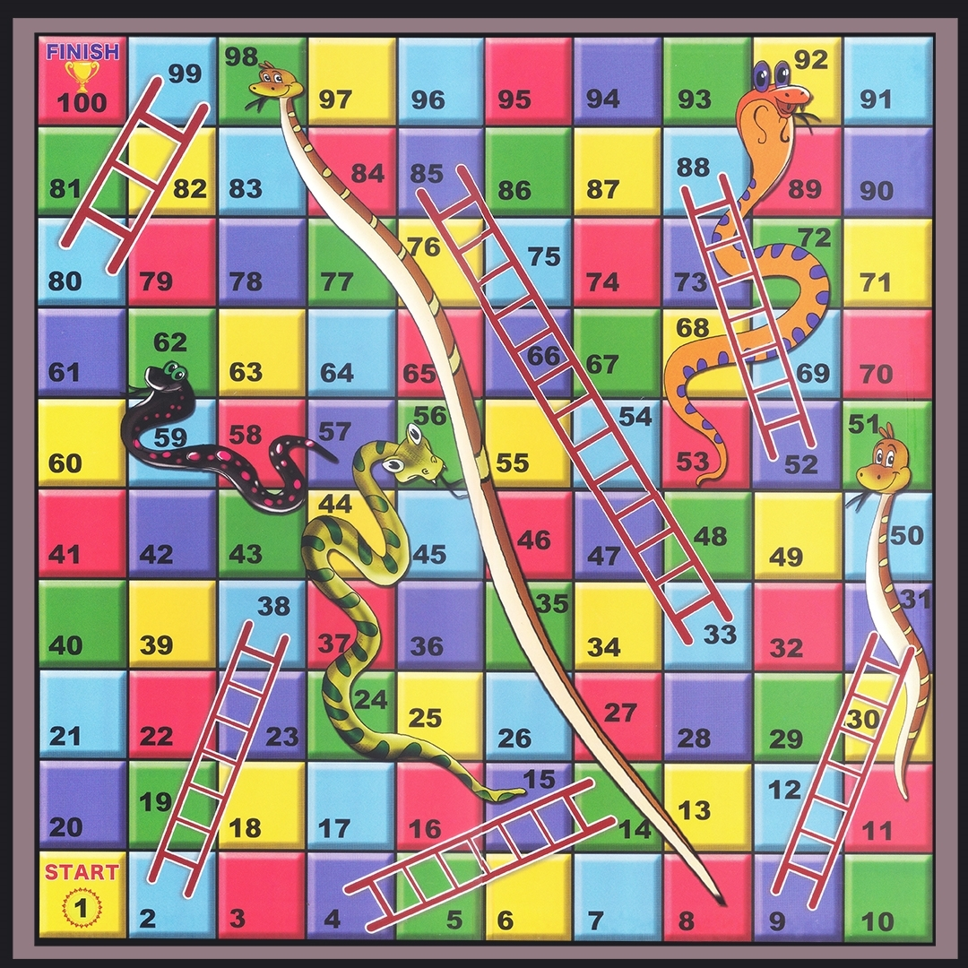
Dynamic Ludo A snake-and-ladder game with new features
Presented by
Kazi Shamil Akram
Roll: 231104
Supervised by
Dr. Md. Mahbubul Alam Joarder
Professor, IIT

Slide 2
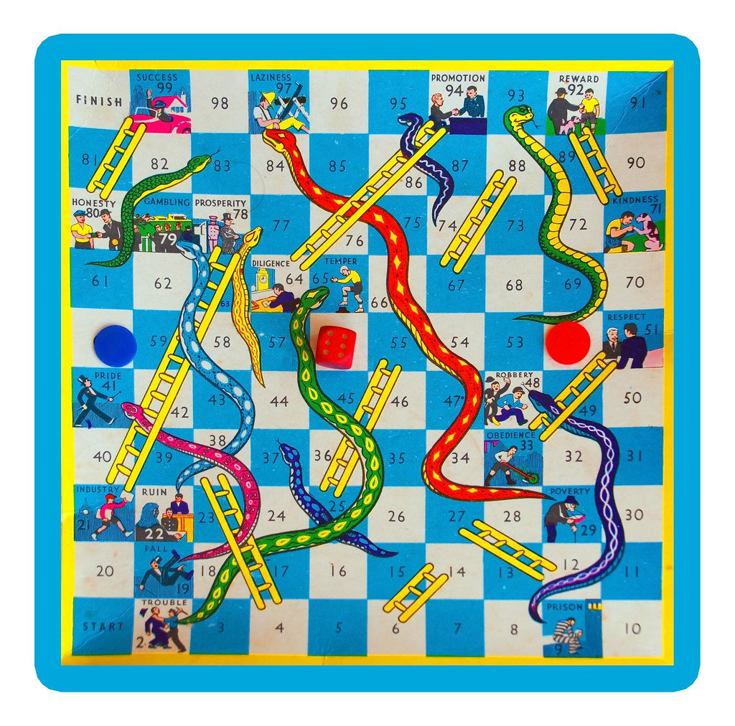
Project overview
The project seeks to create a snake-and-ladder game program
that has random obstacles, points and punishments.
It can also be played from different devices,
with up to four people.
ThePhoto by PhotoAuthor is licensed under CCYYSA.

Slide 3
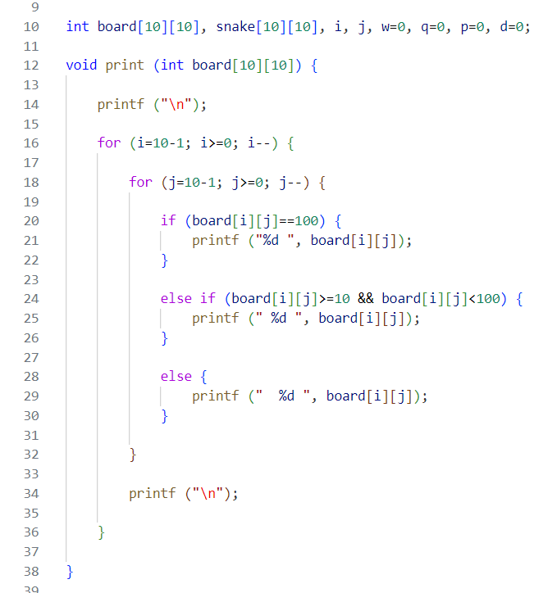
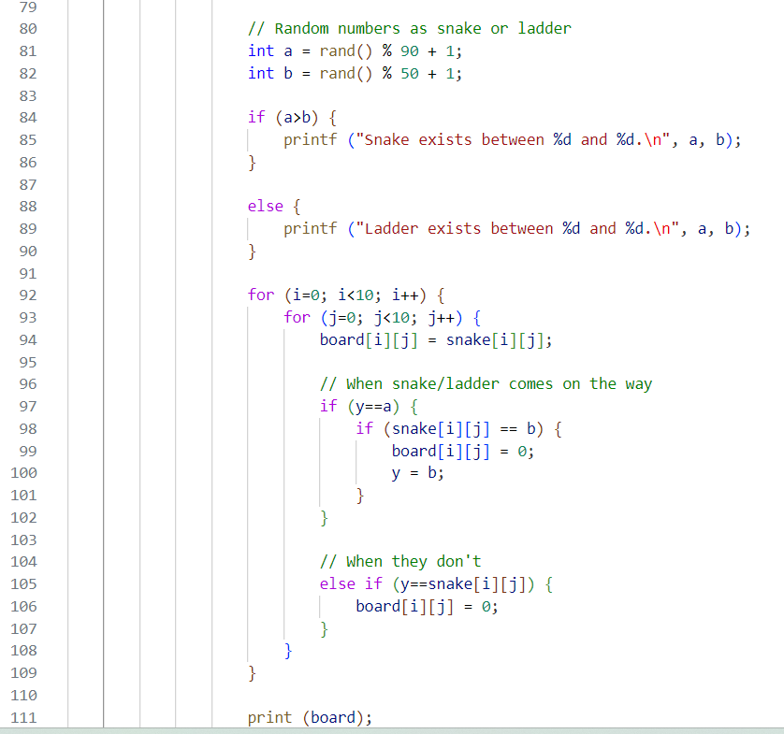
Activities
Setting up a ludo board and basic logic.

Slide 4
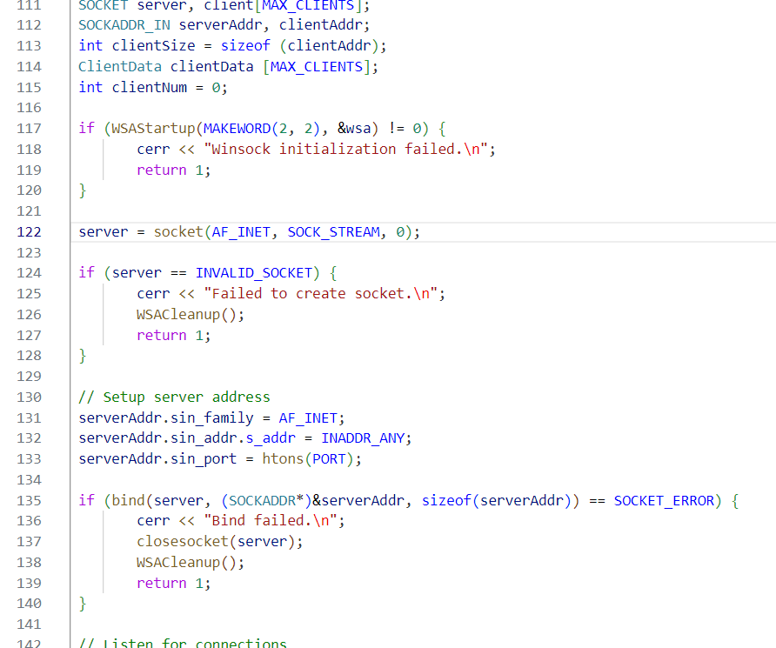
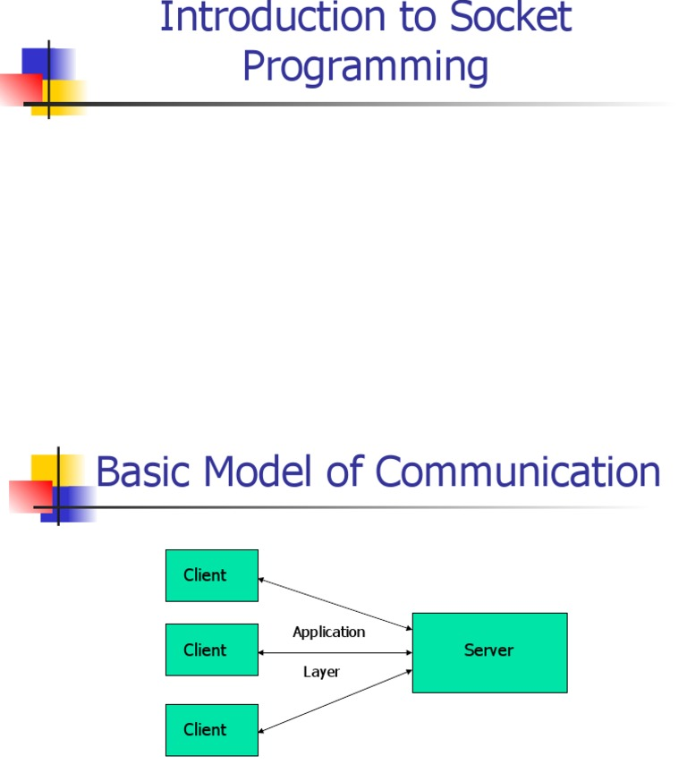
2) Setting up a server with multiple sockets.

Slide 5

3) Setting up a client.
Configuring how the client, the player, can send its current position to the server with and without timeout.

Slide 6
4) Adding dynamic features
Namely:
A randomly generated number as the dice,
a set of variables containing random number, representing snake and ladder's beginnings and ends,
checking up the 5-second timer,
Setting a limit of total "lives" for each failure to give input timely,
"life" increasing and decreasing at random positions.

Slide 7
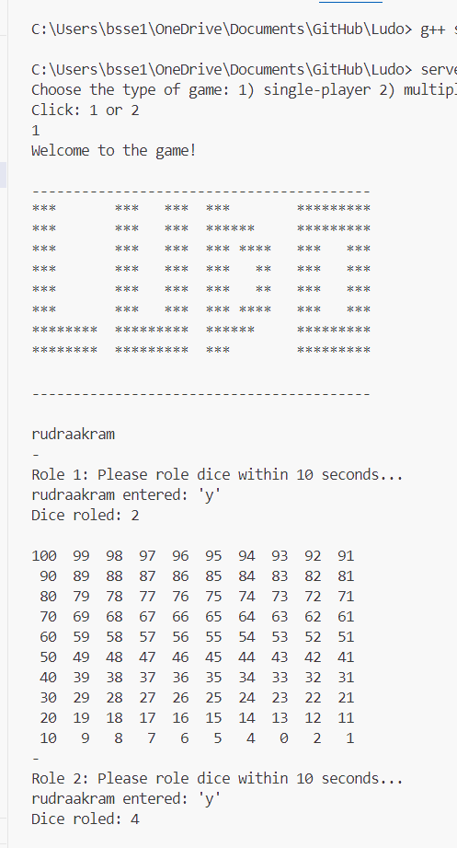
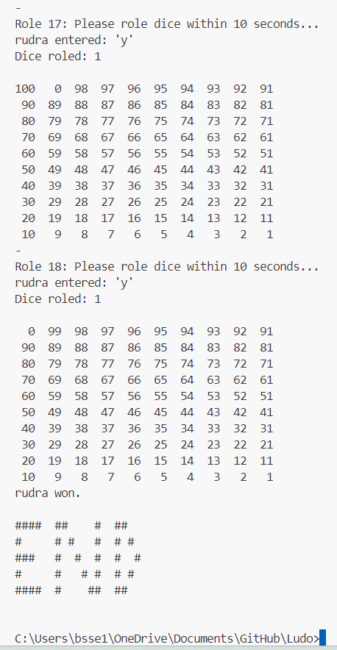
Final results:
Beginning- left Ending- right
Line of code: 1100
Libraries used: winsock.2, stdlib.h, time.h, conio.h, stdio.h
Language: C++, C
Tools: GitHub, VS Code

Slide 8
Why dynamic ludo?
Challenging with obstacles and tile limits.
Doesn't need a graphics app.
Can be played with multiple players from different devices.
How can this be extended?
Visualizing obstacles better, allowing to add a user-defined number of players, more players without network overflow.

Slide 9
Thank you!

